Slide 1
Paytm’s Rebirth

Slide 2
Paytm’s Problems
Problem Statement
Non-Compliance
Licensing Breaches
Paytm Payments Bank faces regulatory scrutiny by the RBI due to compliance issues, including KYC* and AML** norms. Urgent action is needed to address these challenges and restore trust.
Data Security Vulnerabilities
Reputational Damage
Operations Halted
*KYC: Know Your Customer
**AML: Anti-Money Laundering

Slide 3
Business Objectives
Reinstate the business(PPBL)
Regain Regulatory Compliance
Restore Customer Trust
Strengthen Internal Controls and Security
Introduce New Features to elevate business

Slide 4

Why now?
The Reserve Bank of India and the Securities and Exchange Board of India (SEBI) have issued a final regulatory notice to PPBL. This notice follows a series of prior warnings concerning non-compliance with KYC* , AML**.
The notice stipulates that PPBL*** has a period of six months to take corrective action. Failure to do so within the stipulated time frame will result in the disqualification of PPBL for future license reinstatement.
*Know Your Customer
**Anti-Money Laundering
***Paytm Payments Bank Ltd

Slide 5
OKRs
To reinstate the halted business operations
Objectives | Key Results | Owner
Regain Regulatory Compliance | Achieve 100% compliance with KYC (Know Your Customer) regulations by the end of 6 months Resolve outstanding issues identified by the RBI audit by the end of 6 months | CEO, CFO
Restore Customer Trust | Resolve the customer complaints and inquiries clearly and promptly Transparency with the customer in terms of the issues faces and actions taken | CTO, CMO
Strengthen Internal Controls and Security | Achieve SOC* 2 compliance for data security (third party) by the end of the fiscal year | CISO, CTO
*SOC - System and Organization Control

Slide 6
Competitive Analysis
Metric | Market Share | Revenue INR (bn) | Transaction Value (bn) | App Downloads (M+) | App rating | Total Users (M)
Paytm | 10% | 79.9 | 1225 | 500 | 4.6 | 300
PhonePe | 49% | 16.46 | 10,016 | 500 | 4.3 | 500
Google Pay | 33% | 14.67 | 6,941 | 500 | 4 | 150
Amazon Pay | 7% | 20.93 | 68 | 500 | 4.5 | 300
[1]Transaction Value, https://www.npci.org.in/what-we-do/upi/upi-ecosystem-statistics
[2]Market Share, https://inc42.com/buzz/phonepe-google-pay-paytm-process-94-of-upi-transactions-march-2023/
[3]App Downloads, https://play.google.com/store/apps?hl=en_US&gl=US

Slide 7
SWOT Analysis
Strengths
Weaknesses
Opportunities
Threats
Brand Recognition: Paytm Bank is highly recognized in India's digital payments sector, building strong customer trust and loyalty.
Diversified Services: Offering a wide range of financial products beyond basic banking, Paytm Bank effectively meets diverse customer needs.
Strong Merchant Network: With a solid network of merchants, Paytm Bank facilitates seamless transactions and enhances customer convenience.
Large User Base: Leveraging its extensive digital payments user base, Paytm Bank has a ready-made customer pool for its banking services.
Reliance on Indian Market: Paytm Bank's heavy dependence on the Indian market could limit its growth potential beyond the country's borders.
Regulatory Changes: Adapting to frequent regulatory changes poses a challenge for Paytm Bank, requiring continual adjustments to operations and compliance strategies.
Financial Inclusion: Paytm Bank can boost inclusion by offering accessible banking to underserved populations, expanding its customer base.
Rural Market Focus: Paytm Bank sees a big chance in rural areas, with custom banking solutions for unmet financial needs.
Global Expansion: Leveraging its brand and tech strength, Paytm Bank could enter new markets for growth and diversification.
Technological Innovation: Innovating in tech can set Paytm Bank apart in fintech, appealing to tech-savvy users.
Competition: Paytm Bank faces strong competition from established banks (e.g., HDFC, ICICI) and emerging fintech firms (e.g., PhonePe, Google Pay), which poses a significant threat to its market share and growth prospects.
Cybersecurity Threats: Paytm Bank faces risks like data breaches and cyber attacks that could harm its operations and customer trust.

Slide 8

Gap Analysis
Aspect | Current State | Future Challenges and Opportunities | Gap Analysis
Regulatory Compliance | Facing scrutiny and penalties for KYC violations, technology lapses, money laundering accusations | Addressing concerns about money laundering, corruption, fraud; enhancing compliance measures | Gap between current compliance status and future regulatory requirements
Profitability and Scaling | Challenges with profitability, questions about scalability, concerns about being a "cash guzzler" | Demonstrating a clear path to profitability, optimizing operational efficiency, diversifying revenue streams | Gap between current financial performance and future growth expectations
Customer Trust | Negative publicity affecting trust and user retention | Improving transparency, addressing customer concerns, enhancing service quality | Gap between current reputation and required trust to retain user base
Lending Partnerships | Facing challenges in maintaining trust and confidence among lending partners | Strengthening risk management, ensuring regulatory compliance, fostering transparent communication | Gap between current partnership status and required trust for long-term partnerships

Slide 9
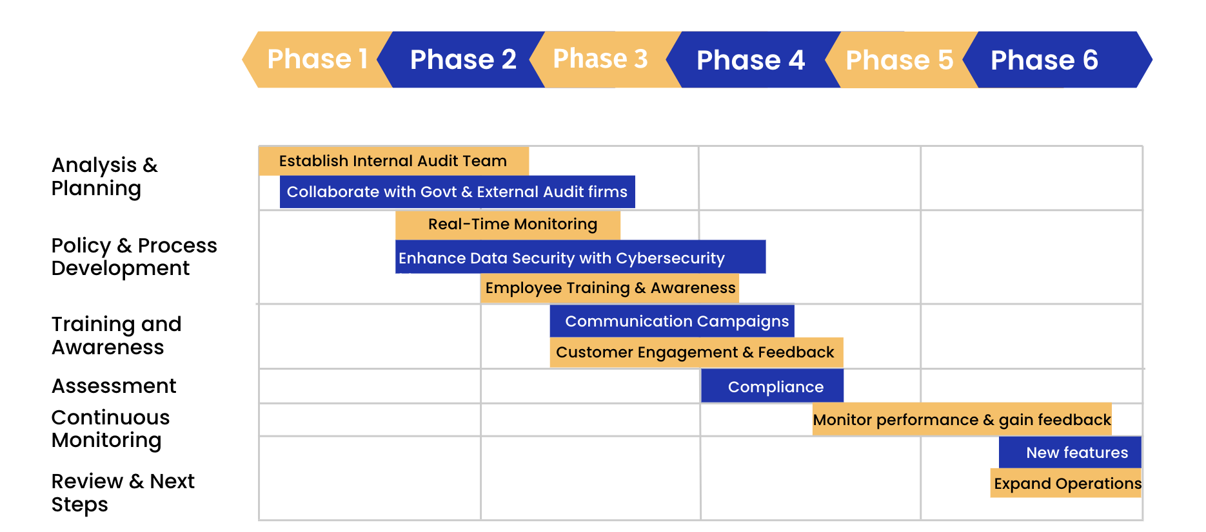
Compliance Roadmap

Slide 10
Personas
Personas
Characteristics
Pain Points
Persona 1
Name: Ramesh Patel
Role: Small Business Owner
Description: Ramesh owns a small electronics store in a bustling market area. He relies on PPBL for daily transactions, receiving payments from customers and making supplier payments.
Tech-Savvy: Uses mobile apps for banking.
Time-Conscious: Prefers quick and efficient services.
Budget-Conscious: Seeks affordable banking solutions.
1) Regulatory Compliance: Worries about regulatory impact on PPBL's services, fearing disruptions.
2) Transaction Fees: Unhappy with high fees affecting profitability.
3)Trust Issues: Concerned about fund safety due to compliance challenges.
Persona 2
Name: Ananya Gupta
Role: Senior Compliance Officer
Description: Ananya is responsible for ensuring that PPBL complies with all regulatory requirements set forth by governing bodies such as the RBI. She oversees KYC processes, anti-money laundering (AML) measures, and other compliance-related activities within the bank.
Detail-oriented: Ensures compliance by closely following regulatory guidelines and updates.
Analytical: Utilizes data analysis tools to assess compliance effectiveness and pinpoint areas for enhancement.
Proactive: Addresses compliance issues preemptively to prevent escalation.
1) Regulatory Scrutiny: Ensures PPBL meets evolving regulatory standards.
2) Resource Constraints: Manages compliance with limited resources and manpower.
3) Stakeholder Expectations: Balances internal demands for efficiency with regulatory compliance.
Persona 3
Name: Rajesh Kumar
Role: Banking Supervision Officer
Description: Rajesh works in the banking supervision department of the RBI, responsible for monitoring and regulating the activities of banks and financial institutions, including PPBL.
Regulatory Expertise: Understands RBI banking regulations deeply.
Investigative Skills: Conducts rigorous inspections for regulatory compliance.
Accountability: Enforces regulations to maintain banking system integrity.
1) Compliance Challenges: Ensuring banks like PPBL adhere to evolving digital banking and fintech regulations.
2) Resource Constraints: Limited resources and manpower to supervise numerous banks and financial institutions.
3) Stakeholder Pressure: Balancing government, banking industry, and public expectations while maintaining financial stability and consumer protection.

Slide 11
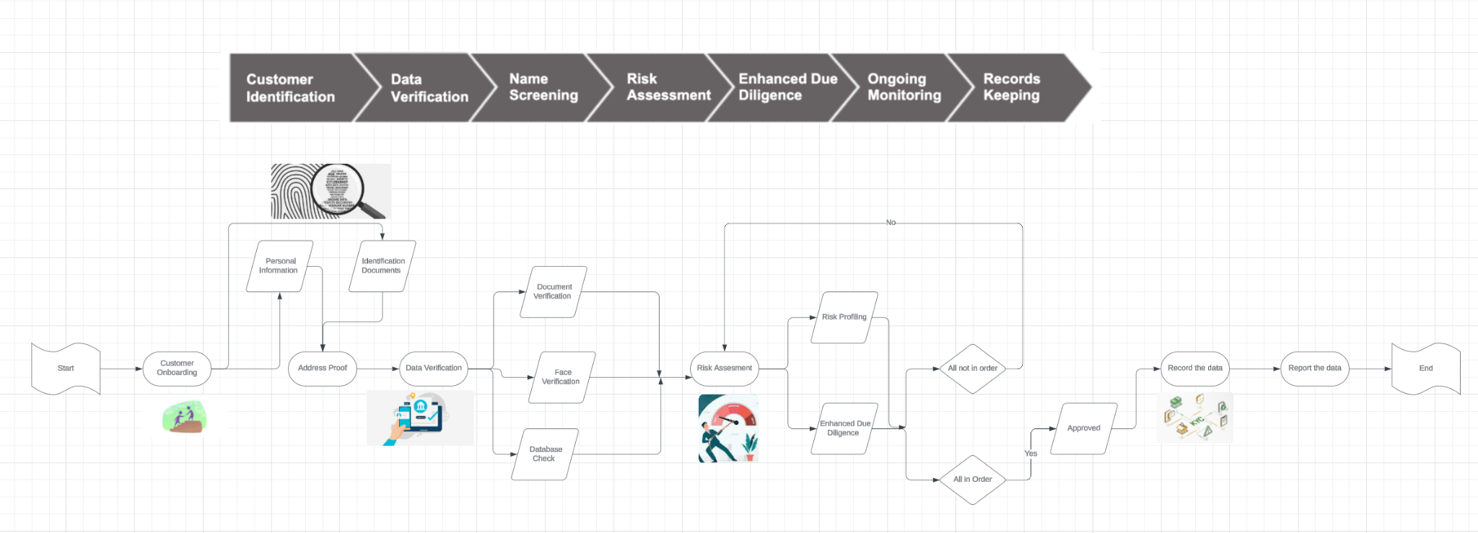
Current KYC Model

Slide 12
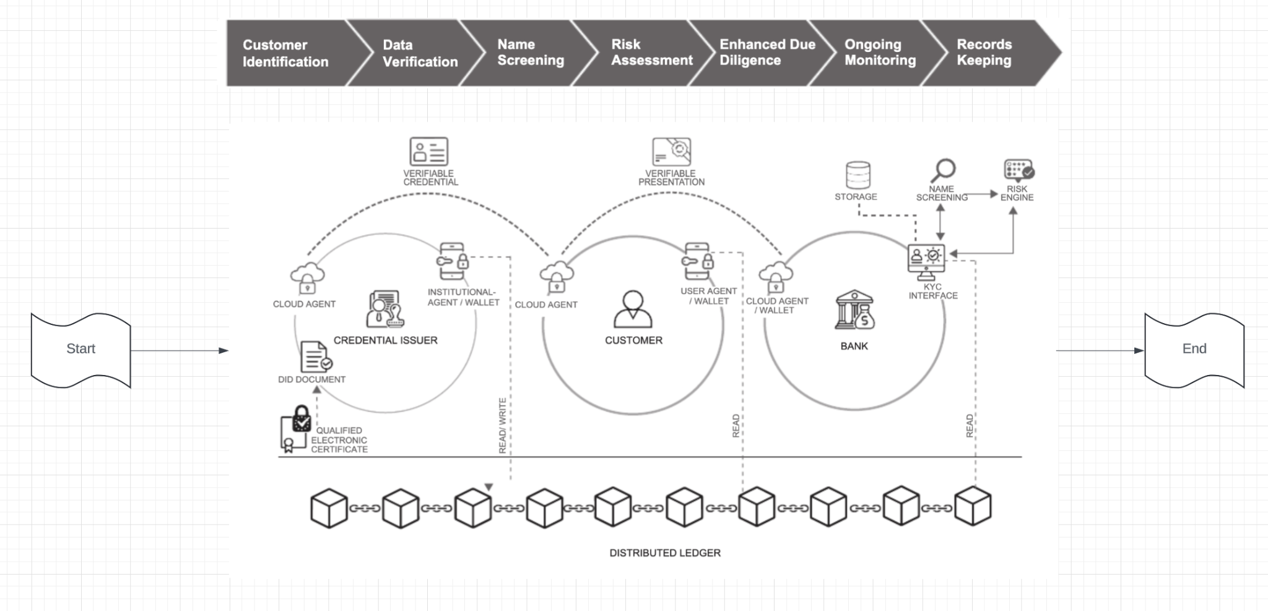
Digital KYC built on Blockchain

Slide 13
Value Chain Analysis
Inbound Logistics
Operations
Outbound Logistics
Marketing and Sales
Human Resources
Firm Infrastructure
Digital Onboarding
KYC Compliance
Technology Integration
Payment Services
Banking Services
Customer Support & Experience
Transaction Processing
Data Management
Risk Management
Brand Promotion
User Acquisition
Merchant Acquisition
Training & Development
Compliance & Legal Issues
HR Information System (HRIS)
Governance
Corporate Social Responsibility
Financial Inclusion & Management

Slide 14
Change Management
What Needs to Change?
Who Needs to Change?
Why Do We Need to Change?
When and how Can We Make This Happen?
Regulatory Scrutiny: Paytm Payments Bank faces regulatory scrutiny by the RBI due to compliance issues, including KYC and AML norms.
Loss of Trust: Compliance issues have led to a loss of trust among customers and stakeholders.
Operational Efficiency: There is a need to improve internal controls and operational efficiency to prevent future compliance breaches.
Business Sustainability: To ensure long-term sustainability and profitability, Paytm Payments Bank must align with regulatory standards and customer expectations.
Senior Management: Leadership must drive the change, ensuring alignment with regulatory requirements and strategic business objectives.
Compliance Team: The compliance team needs to adopt and implement new processes and systems to meet regulatory standards.
IT and Security Teams: These teams must enhance the security infrastructure and internal controls to safeguard against compliance breaches.
Customer Service Team: Frontline staff must be trained to handle customer concerns and maintain high standards of service.
Compliance Processes: Update and strengthen KYC and AML compliance processes to meet regulatory standards.
Internal Controls: Enhance internal controls and security measures to prevent compliance issues and fraud.
Customer Relationship: Rebuild customer trust through transparent communication and improved service.
Product Offerings: Introduce new features and services to enhance the customer experience and business growth.
Staff Training: Train staff on compliance requirements and customer service best practices.
We incorporate this plan in 6 months
Stakeholder Engagement: Communicate the need for change to all stakeholders, including employees, customers, and regulatory bodies, and seek their support.
Implement New Compliance Systems: Invest in technology and systems to streamline KYC and AML processes and enhance internal controls.
Conduct Training Programs: Provide comprehensive training for employees on new compliance requirements and customer service standards.
Monitor and Evaluate Progress: Regularly monitor the implementation of changes and evaluate progress against set objectives and key results (OKRs).

Slide 15
Policies, Regulation, Privacy
1. Regulatory Reports:
KYC (Know Your Customer) compliance reports, Suspicious transaction reports (STRs)
AML (Anti-Money Laundering) reports (per Prevention of Money Laundering Act (PMLA),2002, Data privacy compliance reports(per PCI DSS*)
2.SOC** 2 Compliance:
Security, Availability, Processing Integrity, Confidentiality, and Privacy of Customer Data(third party usage)
3.SOX` Auditing:
Strong internal controls, transparency in financial reporting
4.Financial Reports:
Balance sheet, income statement, and cash flow statement.
Providing updates on financial performance and key metrics
Financial events or transactions: Including mergers, acquisitions, or large investments
*Payment Card Industry Data Security Standard
**Systems and Organizations Control
`Sarbanes and Oxley Act

Slide 16
Risks and Mitigation
Risk | Mitigation
Difficulty achieving 100% KYC compliance within timeframe | Streamline KYC process, incentivize user completion, partner with third-party verification services
Inefficient issue resolution impacting customer satisfaction | Implement a robust customer service system, provide multi-channel support options, invest in employee training for complaint handling
Delays in achieving SOC 2 compliance | Partner with experienced security consultants, invest in robust security infrastructure, prioritize employee awareness training on cybersecurity
Data breaches leading to customer information leaks | Implement robust data encryption protocols, conduct regular security audits, prioritize vulnerability management, enforce data access controls

Slide 17
Thank you!

Slide 18
Appendix

Slide 19
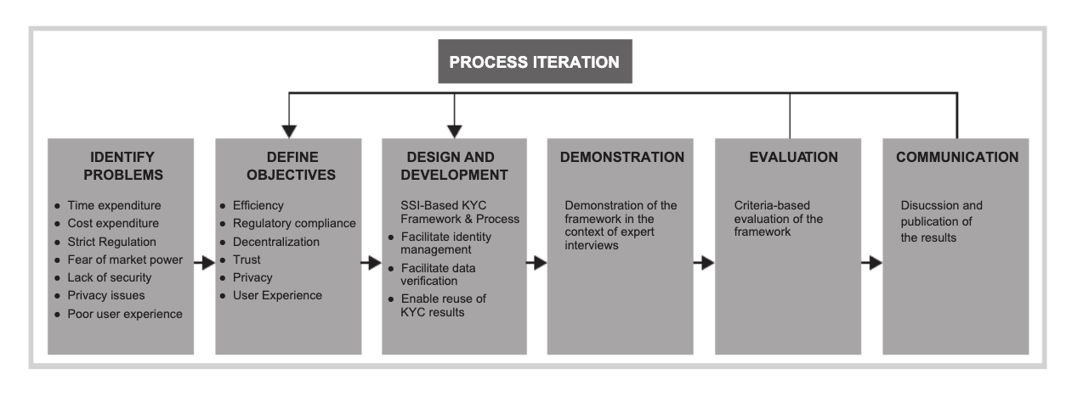

Slide 20
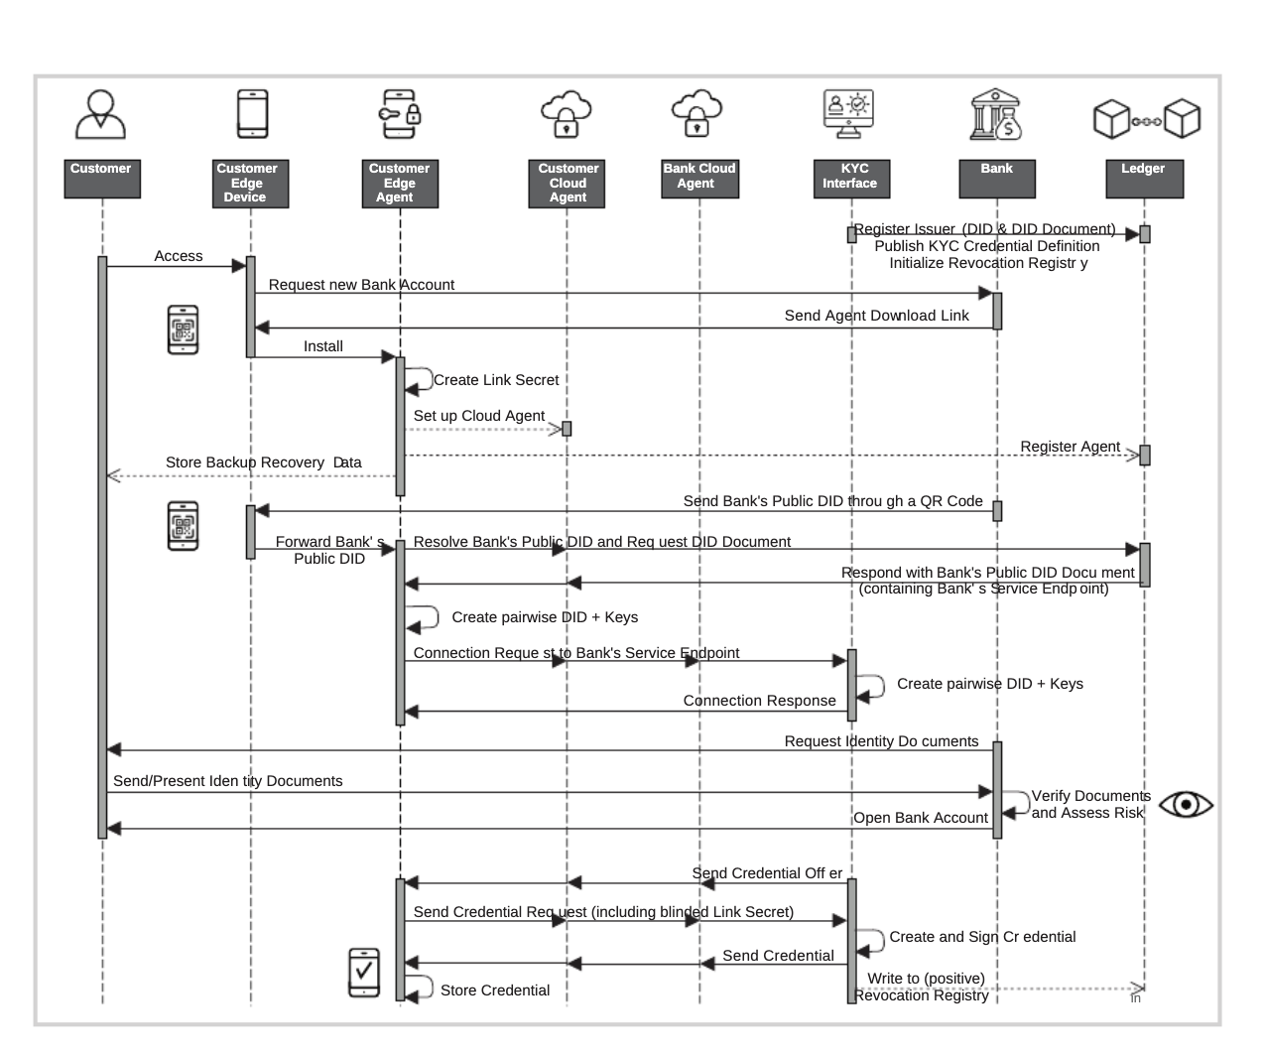

Slide 21
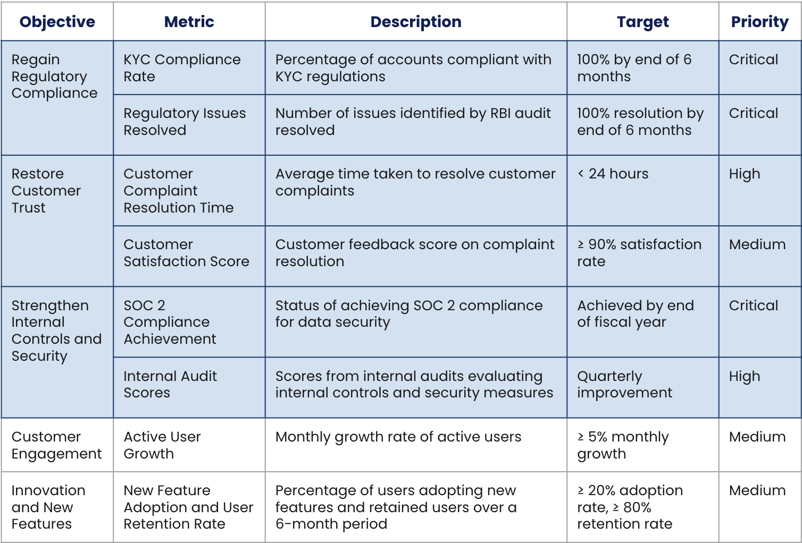
Evaluation Metrics

Slide 22
https://www.researchgate.net/publication/355747337_Designing_a_Framework_for_Digital_KYC_Processes_Built_on_Blockchain-Based_Self-Sovereign_Identity

